Slide 1

Indoor Positioning Systems
A Study of Geometrical, Probabilistic, and Predictive Localization
Group 2 — Muhammad Omais RANA & Xavier KNOEPFFLER-POUT
March 24, 2026

Slide 2



Three Approaches to Indoor Localization
This study explores three fundamental methodologies for Indoor Positioning Systems (IPS), each addressing unique challenges in tracking mobile terminals within indoor environments. From geometric calculations to probabilistic matching and predictive modeling, these approaches form a comprehensive foundation for movement-tracking technologies.
N-Lateration
Fingerprinting
Markov Models
Geometrical approach using distance measurements from multiple access points
Probabilistic method comparing radio signal patterns across locations
Predictive algorithm learning movement patterns and building constraints

Slide 3
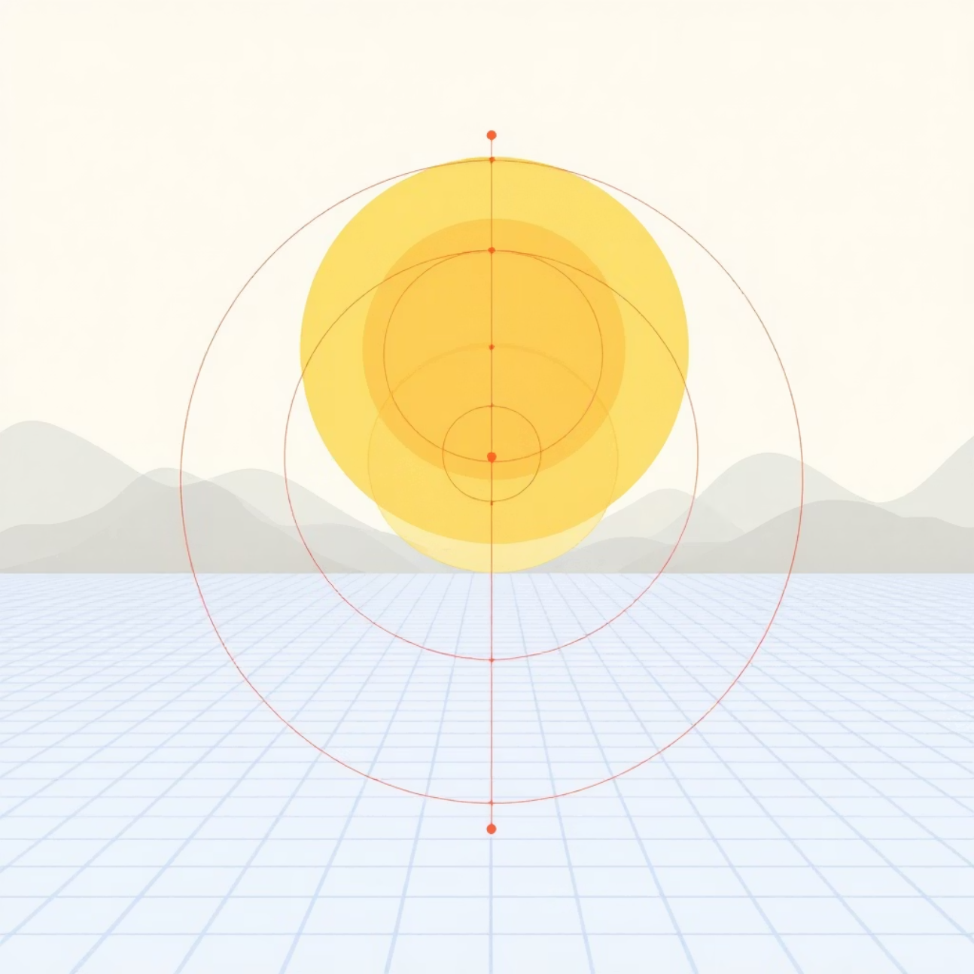
N-Lateration (Geometrical Approach)
What is N-Lateration?
N-Lateration is a geometrical method used to determine the position of a Mobile Terminal by measuring its distance from multiple known Access Points. In reality, signal noise prevents perfect circle intersections, creating a "zone of uncertainty" that requires sophisticated algorithms to resolve.
How Grid Search Works
The algorithm uses Grid Search paired with the Sum of Absolute Errors (SAE) to find the most likely position:
The physical room is divided into a virtual grid of tiny points
A hypothetical user is placed at every point, calculating expected distances
SAE subtracts "guessed" distances from actual measured distances
The point with the lowest total error is selected as the position

Slide 4
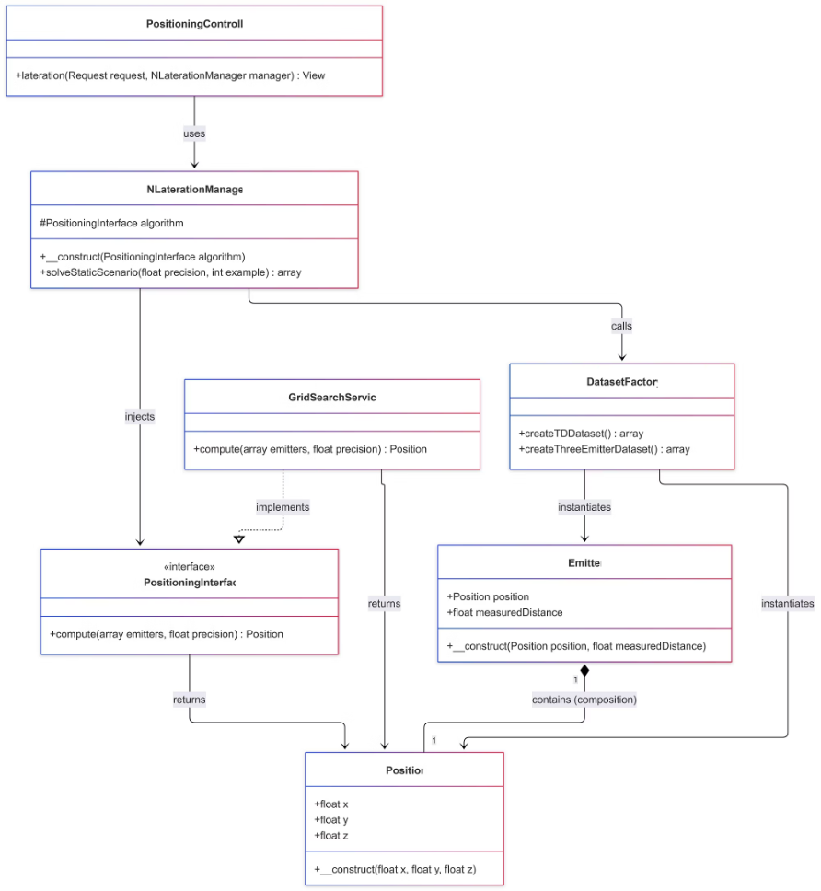
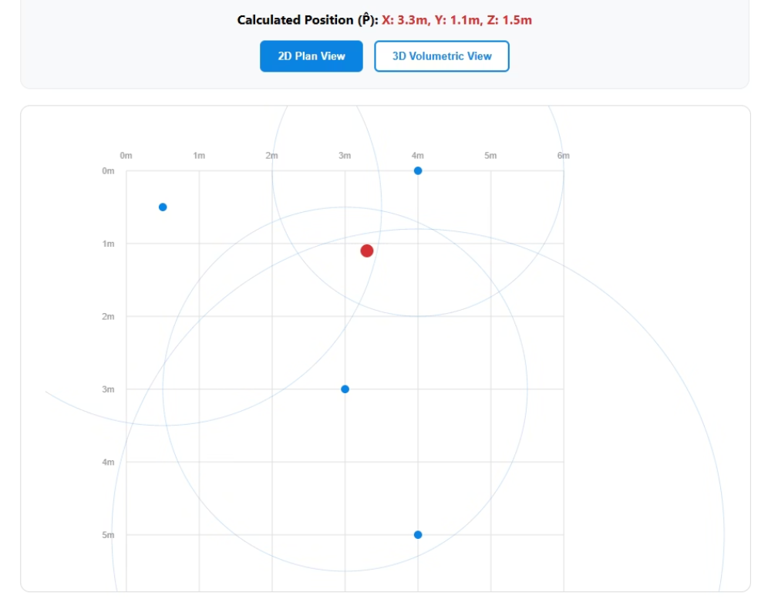
N-Lateration Architecture & Results
01
02
Position & Emitter
DatasetFactory
Function: Position stores spatial x, y, z coordinates. Emitter wraps a Position and attaches a measured distance (converted from signal strength). Impact: Provides the core geometry data required to construct intersecting bounding boxes and radius constraints.
Function: Initializes mock environments (createTDDataset, createThreeEmitterDataset), spawning arrays of Emitter configurations. Impact: Allows testing both the N = 4 and N = 3 scenarios instantly without live sensor hardware being present.
03
04
PositioningInterface
GridSearchService
Function: Enforces a strict compute(emitters, precision) signature. Impact: Guarantees standard input and output (a Position) regardless of the specific mathematical solver used.
Function: Implements the PositioningInterface to iterate a mesh of coordinates measuring Euclidean errors for minimum residual values. Impact: Provides robust geographic estimates under heavy noise mapping when traditional linear algorithms fail to perfectly intersect.
05
06
NLaterationManager
PositioningController
Function: Serves as the intermediary that binds the DatasetFactory to the algorithm (GridSearchService). Impact: Decouples the configuration logic from the HTTP requests, allowing standalone programmatic testing.
Function: The web entry point. Parses the user request and renders the Canvas graphic output using the computed results. Impact: Provides the HTTP interface for N-Lateration operations.
Figure 2: Visual outcome of N-Lateration tracking with 4 emitters
Figure 1: UML Class Diagram for N-Lateration Architecture

Slide 5





Fingerprinting
(Probabilistic Approach)
Understanding Fingerprinting
Fingerprinting acknowledges physical layout interference by taking a mathematical "photograph" of radio signals in a room to look for similarities. Rather than calculating geometric distances, this method compares signal patterns to identify location.
The Radio Map
Stored grid of "Radio Signatures" across the physical space
Signal Distance
Compares live readings using Euclidean signal distance
K-Nearest Selection
Ranks cells by similarity and selects top K matches
Barycentric Weighting
Closest signals exert higher "pull" on final result

Slide 6
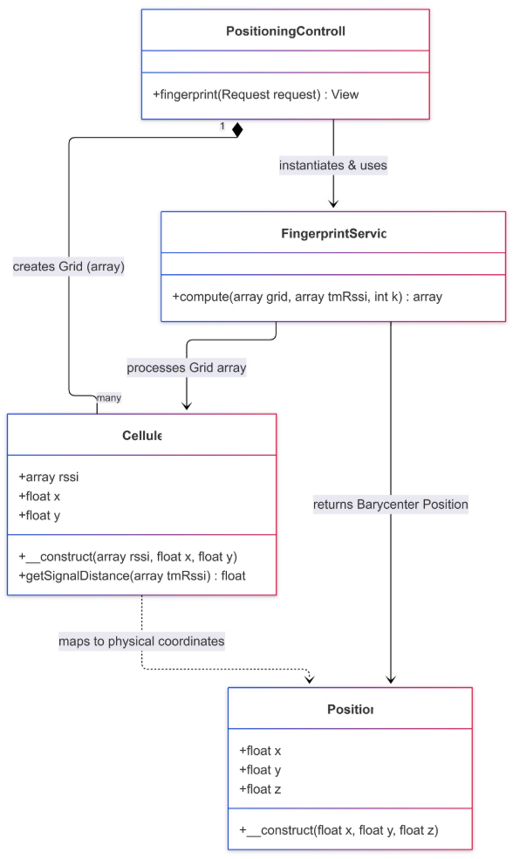
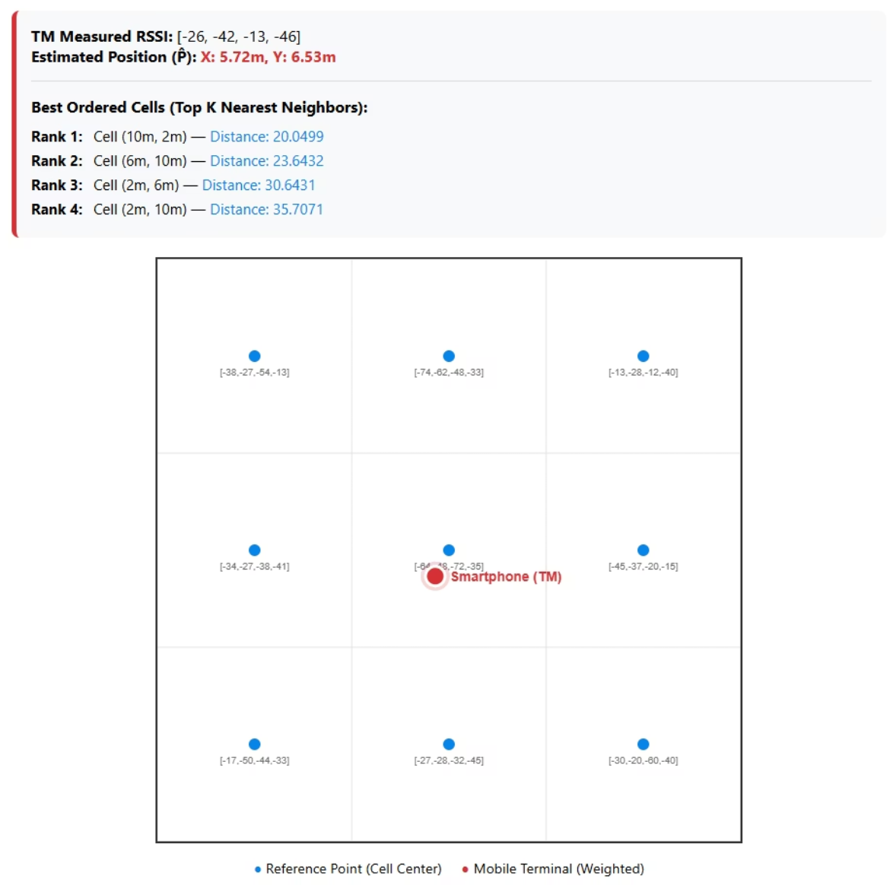
Fingerprinting Architecture & Results
01
02
03
Cellule
Position
FingerprintService
Physical sector mapped with baseline RSSI signatures. Uses getSignalDistance() to compare signal topology instead of physical geometry.
Physical location output used to calculate the barycenter of the nearest neighbors.
Runs compute(grid, tmRssi, int k), ranks signal distances, selects the top K neighbors, and averages them for location approximation.
04
05
PositioningController (TD3 Context)
RadioMap (Grid)
Exposes fingerprint() to inject the offline grid and pass the target tmRssi signature to the service.
Offline database of established signal signatures that enables K-Nearest Neighbors matching.
Figure 3: UML Class Diagram for Fingerprinting Architecture
Figure 4: Visual outcome of WKNN Barycenter calculation

Slide 7

Dynamic Markov Models (Predictive Approach)
Anticipating Movement Behavior
A Markov Model anticipates human movement behavior by learning building constraints and habit loops. Rather than measuring signals, this approach observes spatial patterns and predicts future locations based on historical movement data.
1
Tallying Phase
Assigns tally marks to specific routes between cells as users move through space
2
Building the Matrix
Translates route tallies into percentile probabilities for transition patterns
3
The Prediction
Targets the highest probability in the current cell's matrix row to anticipate next move

Slide 8
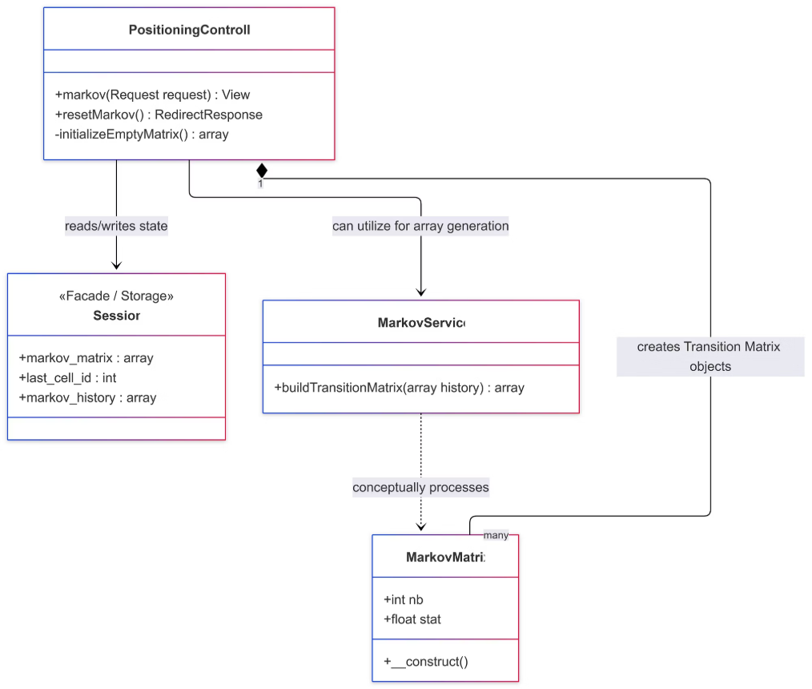
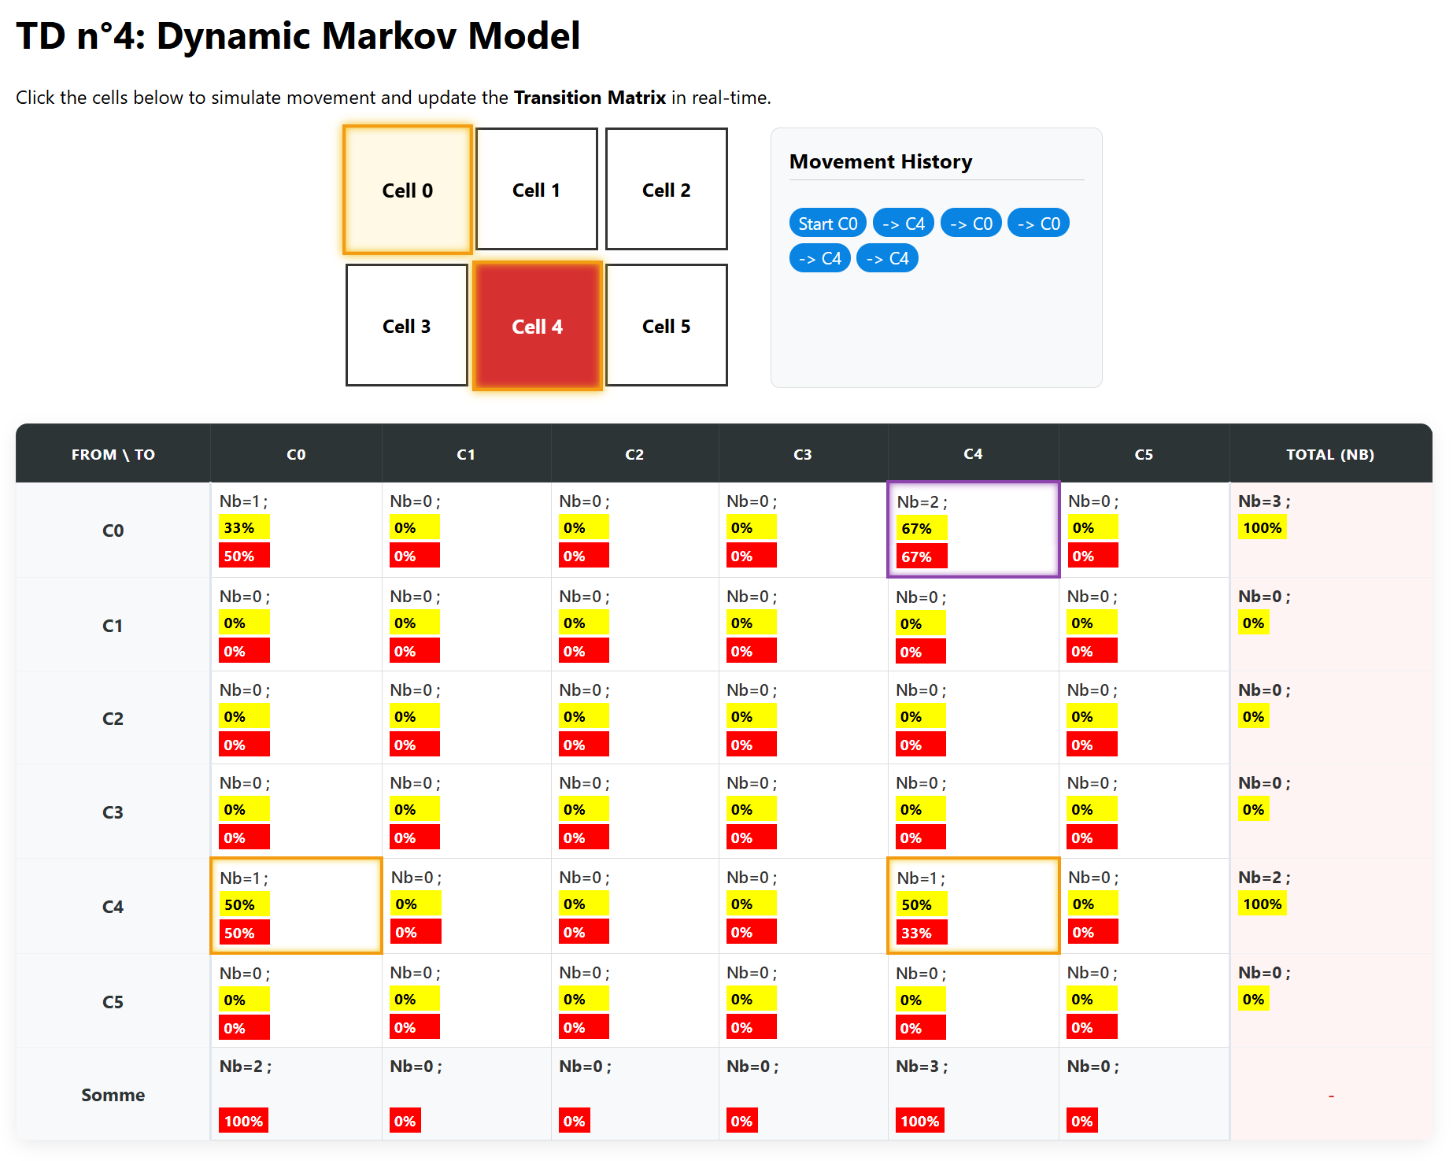
Markov Model Architecture & Results
01
02
MarkovMatrix
Session (Facade)
Contains integer counts (nb) and decimal probabilities (stat) mapped inside individual class instances. Wraps raw algorithmic data into a stable Object, preventing null-pointer errors and type-juggling crashes in the UI table loop.
Native Laravel storage persisting arrays like markov_matrix and markov_history across HTTP reloads. Critical for building State Memory. Markov chains require contextual timeline knowledge; the Session facade is what allows transitions to accrue progressively step-by-step.
03
04
MarkovService
PositioningController (TD4 Context)
Provides mathematical matrix construction tools like buildTransitionMatrix(). Takes linear history sequences and converts them into normalized row probability metrics used by the interactive physics mapping graph.
Processes the move_to query bounds in markov(), updates the Session, updates the MarkovMatrix arrays, calculates the predictive maxProbability cell logic, and commands the blade engine to update the frontend Vis-Network graph. Orchestrates the complete prediction pipeline from user input to visual output.
05
Transition Matrix Builder
Translates route tallies into percentile probabilities for movement prediction patterns. Converts raw movement history into normalized probability distributions for state prediction.
Figure 6: UML Class Diagram for Markov Model
Figure 7: Dynamic Prediction View

Slide 9
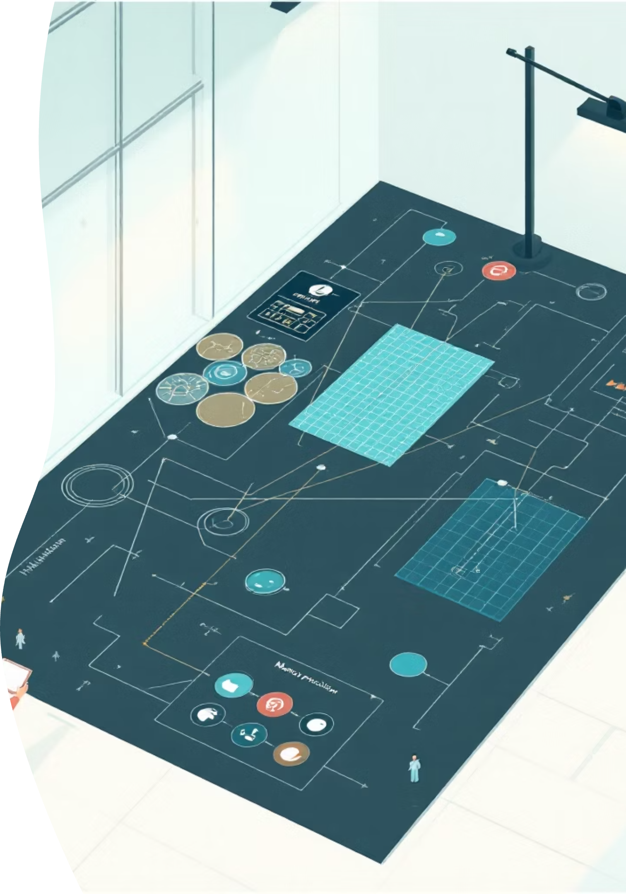
Comparative Results Analysis
N-Lateration Performance
Fingerprinting Accuracy
Grid search with SAE provides robust geometric estimates under heavy noise mapping, handling N=4 and N=3 emitter scenarios effectively
WKNN with barycentric weighting functions as the brain behind TD3, allowing location approximation inside severe static environments
Markov Prediction
Stochastic chain observing spatial habits rather than raw hardware signals, building state memory progressively through session persistence

Slide 10










Conclusion: A Robust Architectural Foundation
Each algorithm solves a unique facet of Indoor Positioning Systems. Together, N-Lateration, Fingerprinting, and Markov computing form a comprehensive architectural foundation for movement-tracking technologies.
Pattern Recognition
Geometric Precision
Signal matching algorithms
Distance-based calculations
Behavior Prediction
Movement anticipation
Layered Architecture
Modular design patterns
Noise Resilience
Handles signal interference
These three methodologies—geometrical, probabilistic, and predictive—demonstrate how diverse algorithmic approaches can be combined to create robust indoor positioning solutions capable of handling real-world challenges like signal noise, physical interference, and complex movement patterns.

